Slide 1
Business Model

Slide 2
Community
Subset recognizing the advantage of correcting their RE
Process for reaching them or them accessing the providers
Determine the RE & give prescription
Access to Glasses
RE correction as a example
Supply Chain
Providers Challenges
Barrier
Awareness

Slide 3
Current Business Focus
Diagnostic space
Treatment space
Process improvements

Slide 4
Platform as Business Model
Manufacturer
Supplier
Patient
Services
Provider

Slide 5
Babylon Health

Slide 6
Collaborative Business Model
Manufacturing
Regulatory
Information
Logistics

Slide 7
Building a new business model
Long-term vs. Short-term
Building the business on “new customers”
Needs patient capital
Process Success vs. Business Success

Slide 8
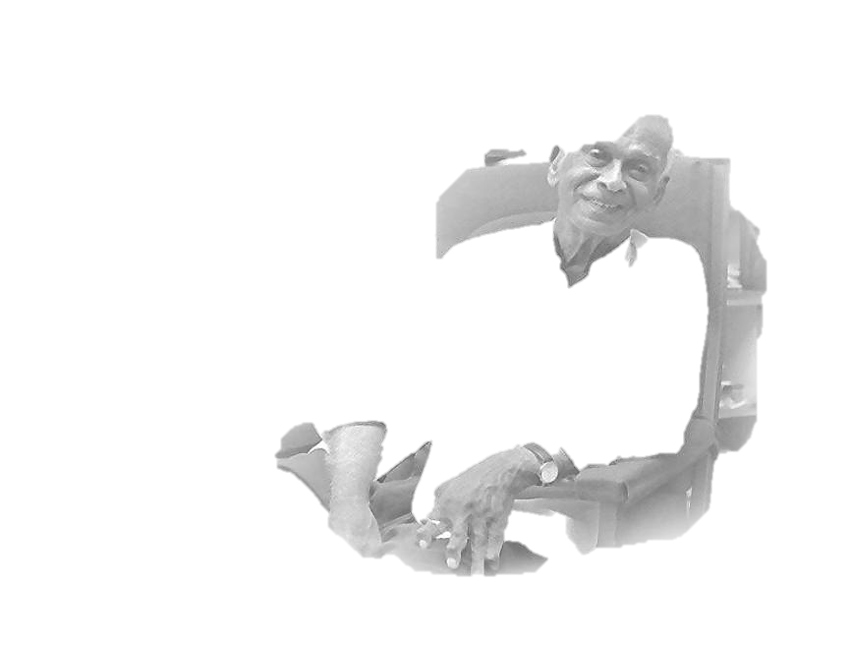
Thank you
“Imperfect is the joy, not shared by all”
- Dr. G. Venkataswamy

