Slide 1
Source: Blue Ocean SHIFT, Beyond Competing By: W. Chan Kim & Renee Mauborgne & From Market Driven to Market Driving By Nirmalya Kumar, IMD, Lausanne Lisa Scheer, University of Missouri, Columbia Philip Kotler, J.L.Kellogg Graduate School of Management, Northwestern University

Slide 2
The Profit and Growth Consequences of Creating Blue Oceans

Slide 3
BLUE OCEAN STRATEGY
Red Ocean Versus Blue Ocean Strategy
Red Ocean Strategy
Blue Ocean Strategy
Companies in existing market space
Create uncontested market space
Beat the competition
Make the competition irrelevant
Exploit existing demand
Create and capture new demand
Make the value-cost trade-off
Break the value-cost trade-off
Align the whole system of firm’s activities with its strategic choice of differentiation or low cost.
Align the whole system of the firm’s activities in pursuit of differentiation and low cost.

Slide 4
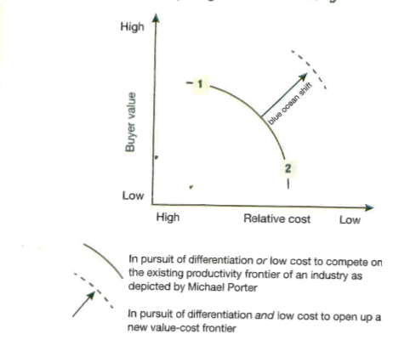
From Market Competing to Market Creating

Slide 5
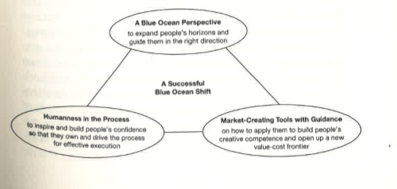
The Three components of a Successful Blue Ocean Shift

Slide 6
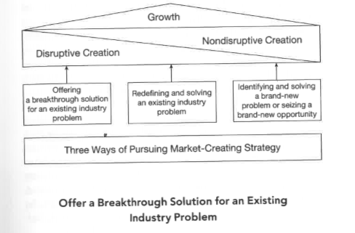
A Growth model of market creating strategy

Slide 7
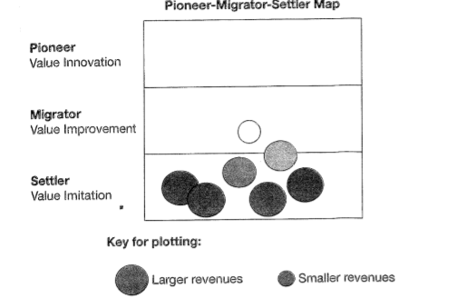
The Pioneer-Migrator-Settler map of a Consumer Appliance Company

Slide 8
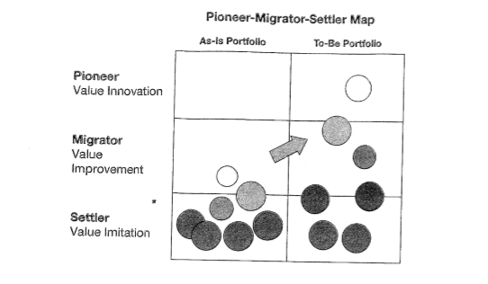
Creating a healthy balance portfolio: The case of the consumer appliance company

Slide 9
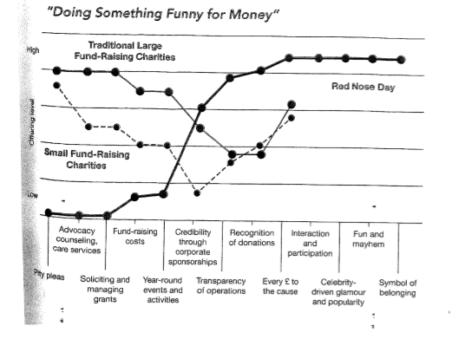
Strategy canvas of Comic Relief

Slide 10
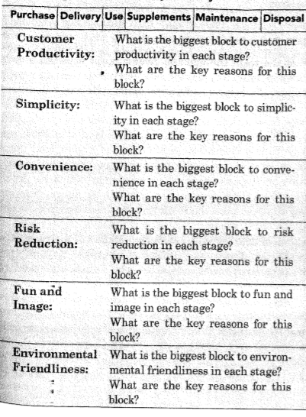
Uncovering the Blocks to Buyer Utility

Slide 11
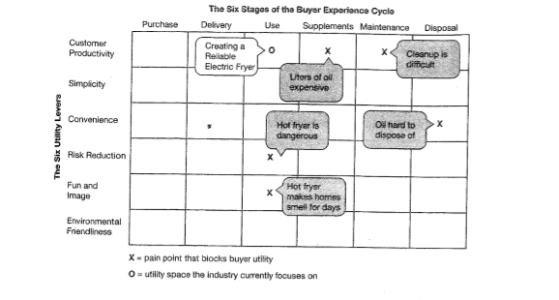
The Buyer Utility map of Electric Home French Fry Makers: Pre-Groupe SEB’s ActiFry

Slide 12
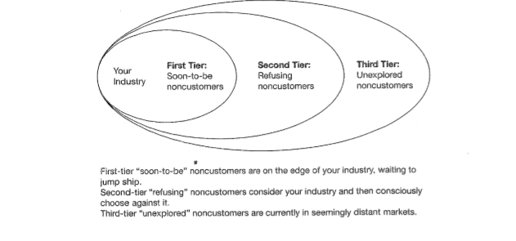
The Three Tiers of NonCustomers

Slide 13
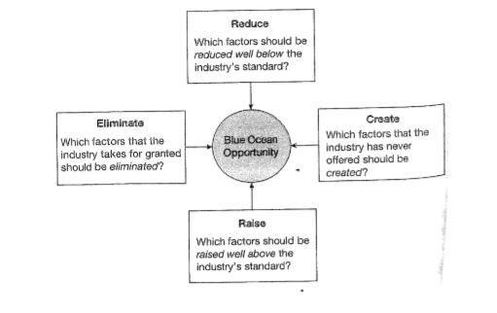
The Four Actions Framework

Slide 14
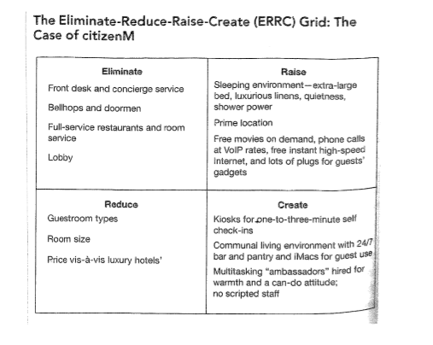

Slide 15
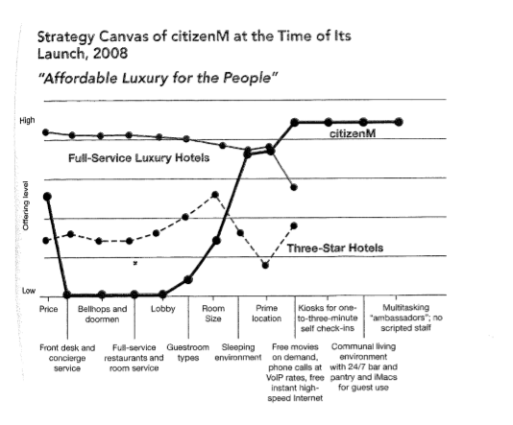

Slide 16
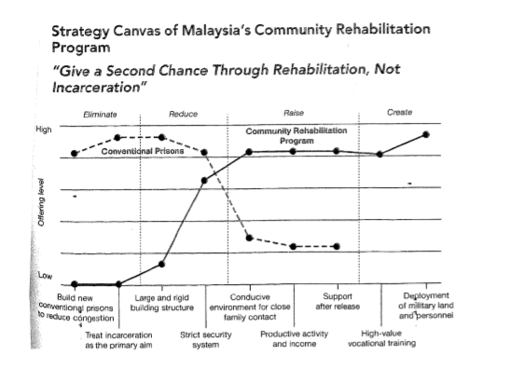

Slide 17
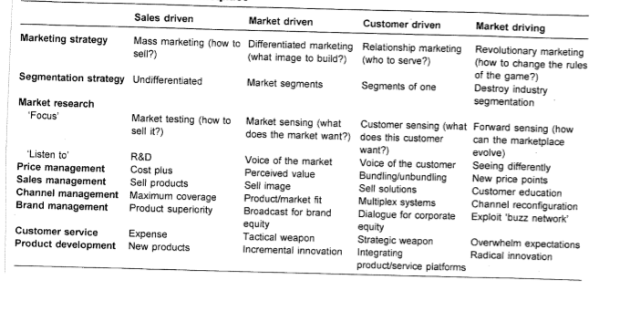
Four Orientations to Marketplace

Slide 18
Value Innovation: The Cornerstone of Blue Ocean Strategy
.
Costs
Value
Innovation
Buyer Value
The Simultaneous Pursuit of Differentiation and Low Cost

Slide 19
Graphs depicting the U.S. Auto Industry’s Profit Pool and the PC Industry’s Profit Pool have been sourced from the HBR article “Profit Pools: A Fresh Look at Strategy”, authored by Orit Gadiesh and James L. Gilbert

Slide 20
The U.S. Auto Industry’s Profit Pool
25%
O
P
E
R
A
T
I
N
G
M
A
R
G
I
N
20
15
10
5
0
New car
dealers
Auto loans
Auto insurance
0
Auto
manufacturing
100%
Used car
dealers
Gasoline
Leasing
Service repair
Auto rental
Warranty
Aftermarket
parts
SHARE OF INDUSTRY REVENUE

Slide 21
The PC Industry’s Profit Pool
40%
O
P
E
R
A
T
I
N
G
M
A
R
G
I
N
30
20
10
0
0
100%
Other components
Software
Personal computers
Services
Microprocessors
Peripherals
SHARE OF INDUSTRY REVENUE

Slide 22
Network Level Strategy

Slide 23
Relational Objectives Inter-Organizational Cooperation Objectives
Relational Objectives
Leveraging Resources
Integrating Activities
Aligning Positions
LEARNING
LENDING
LINKING
LUMPING
LEANING
LOBBYING
The objective is to exchange knowledge and skills
If a firm can not make full use of own resources it can be attractive to lend them to others
Relationships where products/ services are exchanged
Firms bring similar activities together to gain economies of scale
Firms get together to improve their bargaining position vis-à-vis other industry actors
Firms cooperate with one another to gain a stronger position vis-à-vis contextual actors

Slide 24
II. Competition and Cooperation Dealing with the Paradox
Inter-organizational Competition
The act of working against each other, where two or more organizations’ goals are mutually exclusive
Inter-organizational Cooperation
The act of working together with each other, where two or more organizations’ goals are mutually beneficial

Slide 25
III. Network Level Strategy Overview
DISCRETE ORGANIZATION PERSPECTIVE
Competition over cooperation
Independence
Discrete organizations (atomistic)
Distinct & defended boundaries
Arm’s length & transactional relations
Mainly zero-sum (win/lose)
Bargaining power & calculation
No network level strategy
Temporary coalitions (tactic)
Limited, well-defined, contract-based
EMBEDDED ORGANIZATION PERSPECTIVE
Cooperation over competition
Interdependence
Embedded organizations (networked)
Fuzzy & open boundaries
Close & structural relations
Mainly positive sum (win/win)
Trust & reciprocity
Network level strategy
Durable partnerships (strategic)
Broad, open, relationship-based

